Slide 2
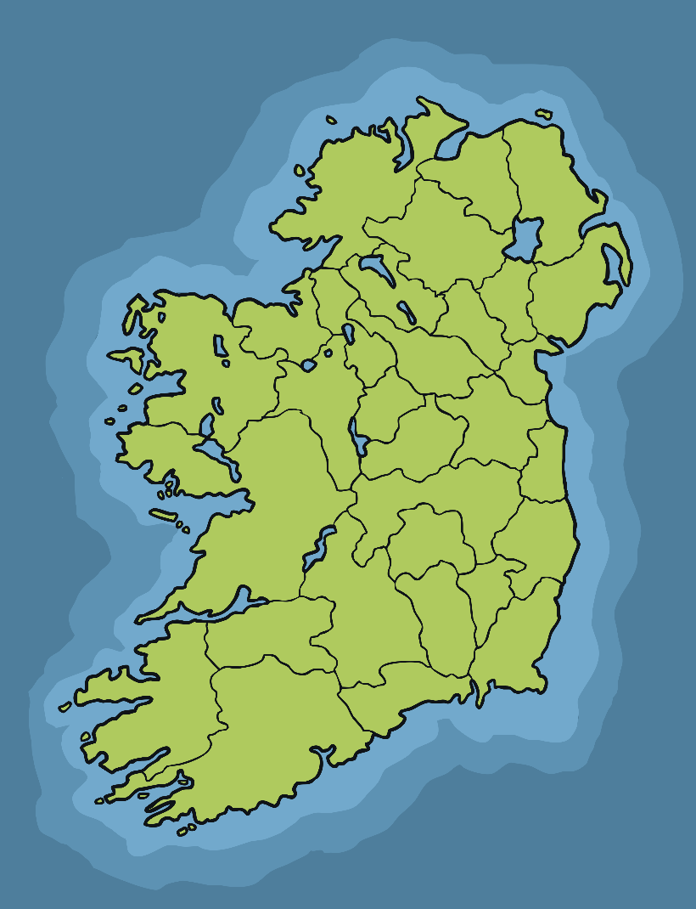
Saint Brigid
Saint Brigid was born in Co. Louth but spent most of her life in Co. Kildare, which is why she is associated most with Kildare.
As a young girl, she heard St. Patrick preaching and was inspired by him.
Kildare, Ireland

Slide 3
Saint Brigid
Brigid was a very kind person.
According to legend, Brigid prayed to God to take her beauty away so that no man would ever fall in love with her.
She wanted to continue to look after the poor and sick.
Her father allowed her to enter a convent and Brigid believed her wishes had been granted by God.

Slide 4
Saint Brigid
We celebrate St. Brigid’s Day on February 1st every year.
People make St. Brigid’s Crosses and hang them in their home.
It is believed that these crosses protect homes from evil spirits.
Photo courtesy of Editor B (@flickr.com) - granted under creative commons licence - attribution

Slide 5
Saint Brigid
The origin of St. Brigid’s Cross comes from the story of an old Chieftain.
He was very sick and called for Brigid to help him.
Brigid is said to have sat at his bed and calmed him by telling him the story of the cross.
She sat using rushes on the ground to make her distinctive cross pattern.
The Chieftain was calmed by her words and asked to be baptized before he passed away.

Slide 6
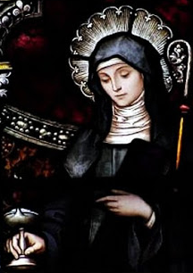
Saint Brigid
St. Brigid died when she was around 70 years old in the year 524.
She is one of Ireland’s most important and famous saints.
St. Brigid on stained glass in St. Joseph Catholic Church, Georgia.

